Slide 1
How the Web Works
Domain Name System

Slide 2
IP Address
Internet Protocol version 4
Uses 32-bit addresses, theoretically allowing 2³² or 4,294,967,296 unique addresses
0.0.0.0 - 255.255.255.255 with certain addresses and ranges reserved
Internet Protocol version 6
Partially created to handle the limited number of IPv4 addresses.
Uses 128-bit addresses, theoretically allowing 2¹²⁸, or approximately 3.4×10³⁸ unique addresses
Consists of 8 groups of 16 bits each, typically represented as hexadecimal values
0000:0000:0000:0000:0000:0000:0000:0000 - FFFF:FFFF:FFFF:FFFF:FFFF:FFFF:FFFF:FFFF

Slide 3
Domain Name System
Provides a hierarchical and distributed naming system for mapping of resources to IP addresses.
Examples:
www.cnn.com --> 151.101.207.5
www.google.com --> 142.250.189.100
www.uab.edu --> 198.73.7.192

Slide 4
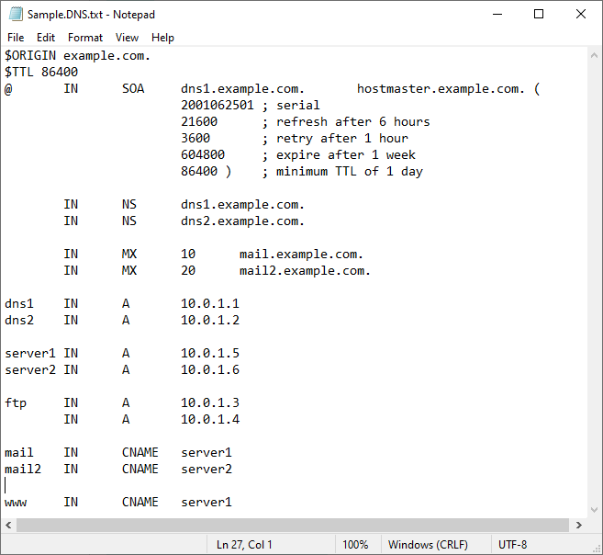
Domain Name System

Slide 5
Domain Name System
Internet Corporation for Assigned Names and Numbers (ICANN)
Internet Assigned Numbers Authority (IANA)
Structure:
www.example.com – three tiered
server.www.example.com – four tiered
Top-level domain
Infrastructure top-level domain (ARPA or Address and Routing Parameter Area)
Generic top-level domains (gTLD)
country-code top-level domains (ccTLD)

Slide 6
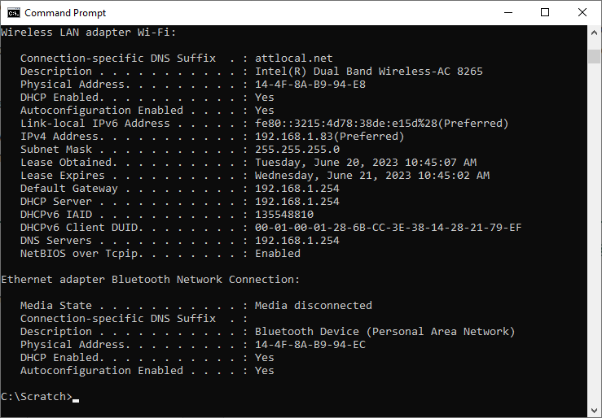
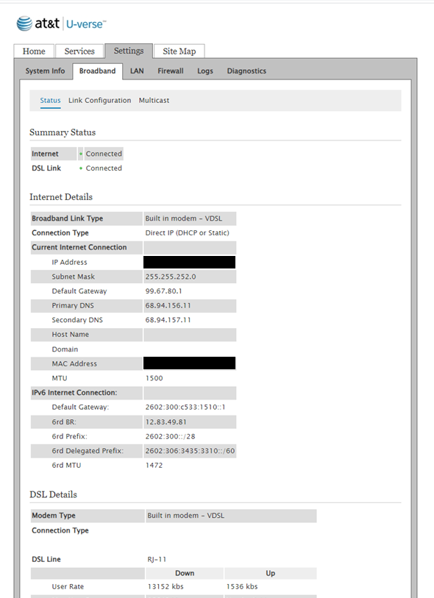
Domain Name System

